Slide 1

Bisection Suggestions
Helper methods and Pseudocode

Slide 2
How many solutions should we look for?
You can know the maximum number of solutions that there can be by looking at the order of the polynomial.
Max possible solutions => (coefficient array length – 1)
A method would be nice to return the max possible solutions so we can tell the client how many solutions have not been found.
public static void main(String[] args) { double[] coeff = {1, 0, -2}; //roots -1.4142, 1.4142 Polynomial poly = new Polynomial(coeff); System.out.println(poly); ArrayList<Double> roots = poly.findRoots(); System.out.println(roots); int rootsLeft = poly.getMaxSolns() - roots.size(); if(rootsLeft > 0) System.out.println("There are " + rootsLeft + " roots not found"); }

Slide 3
How many solutions should we look for?
We might have a double-root
This is where the graph doesn’t quite cross the x-axis, but just touches it
An example of when we have a double root is with a perfect square trinomial
It can cause us to look for more solutions than we need to
We can make a helper method to let us know if a possible solution is one
//pre: x is a solution of our polynomial
//post: returns true if x is a double root private boolean doubleRoot(double x) { double left = x - ALMOST_ZERO; double right = x + ALMOST_ZERO; double f_left = solve(left); double f_right = solve(right); if(sameSign(f_left, f_right)) return true; return false; }
//within a findRoots method…
//assume we have a dataField: maxSolns
//and a local variable to store solutions: solns if(we think we found a solution at lower_bound)
{
if(we can’t find lower_bound in our solution set)
{
solns.add(lower_bound);
if(doubleRoot(lower_bound))
maxSolns--;
if(solns.size() >= maxSolns) //found them all
return solns; //so end the method

Slide 4
Other helper methods for readability
//post: true is x is close enough to zero private boolean isZero(double x) { return (Math.abs(x) < ALMOST_ZERO);
}
//also suggest…
//post: returns the maximum # solutions
public int getMaxSolns()
//post: for a polynomial f, returns f(x) public double solve(double x)
//post: returns soln between upper & lower
private double bisect(double lower,
double upper)
//post: returns roots of a polynomial public ArrayList<Double> findRoots()
{
loop(increment sizes from 1 downTo RESOLUTION)
{//increment sizes cut in half each pass
loop(x from MIN to MAX)
{//x increases by increment size
double lower = x; //lower_bound
double upper = x + increment; //upper_bound
if(there is a solution at lower)
record lower in solns
if(sign change between solve(lower) & solve(upper))
record the result of bisect(lower,upper) in solns
if(we found all solns)
return solns;
}
}

Slide 5
Other helper methods for readability
public String toString() { String retVal = ""; int exp = coeff.length - 1; for(int i=0; i < coeff.length; i++) { if(i > 0 && coeff[i]>0) retVal += " + "; if( coeff[i] != 0) { if(coeff[i] != 1) { if(coeff[i] == (int)(coeff[i])) retVal += (int)(coeff[i]); else retVal += coeff[i]; }
if(exp >= 1) retVal += "x"; if(exp > 1) retVal += "^" + exp + " "; else retVal += " "; } exp--; } return retVal; } }
Show + before term if it is
not the 1st and positive.
Only show terms with a
non-zero coefficient.
Only show x if it is to a
non-zero exponent.
Only show coeff if not 1.
Only show the exponent if it is squared or higher.
If the coefficient is
an integer, show it in integer form.

Slide 6
Binary search Bisection method
//pre: left & right are valid indexes of array
//post:returns index of key withing array,
// searching between indexes left & right
private static int binHelper(int[]array, int key,
int left, int right)
{
if(left > right)
return -1;
int mid = (left+right)/2;
if(array[mid] == key)
return mid;
if(key < array[mid])
return binHelper (array, key, left, mid – 1);
return binHelper (array, key, mid+1, right);
}
//pre: there exists a solution between lower & upper
//post:returns solution of a polynomial (coeff array),
// searching between values lower & upper
private double bisect(double lower, double upper) {
if(there is a solution at lower) return lower; if(there is a solution at upper) return upper;
double mid = the middle point between lower & upper if(there is a solution at mid) return mid;
if(solve(lower) and solve(mid) are different signs) return bisect(lower, mid); return bisect(mid, upper); }
Terminating case(s)
Find the point in the middle. If it is what we want, return it.
Continue on left or right

Slide 7
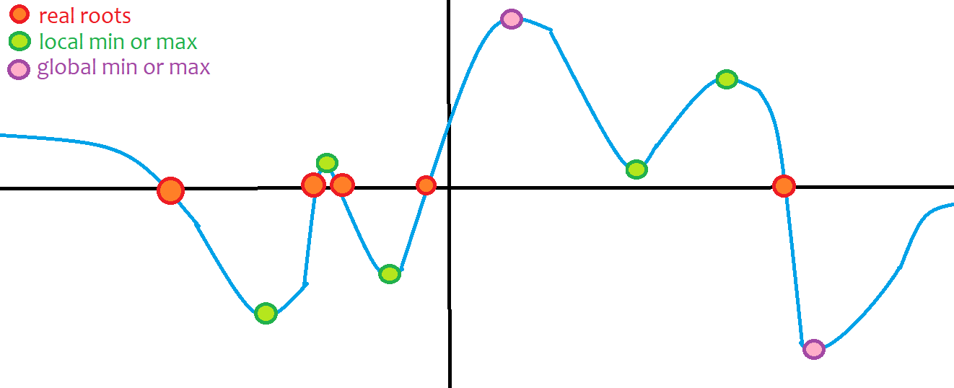
Extension: what other results would be good to know?
In addition to solving for the real roots of a polynomial, it would be nice to know:
Local max and mins (turning points)
Global max and mins (max and min turning points)
Any imaginary roots that can be easily found (like from quadratics)

